Slide 1
CNetS | Center for Complex Networks and Systems Research
The Neutral Competitive Exclusion model
Ru Wang, Alessandro Flammini
Notes:
Good afternoon, today I’ll present neutral competitive exclusion model, which is aimed at mimicing the phonomona that large quantities of memes compete with each other and can coexsitence on the social network

Slide 2
Outline
Motivations and Background
Neutral Competitive Exclusion Model
Simplified Toy Neutral Competitive exclusion Model
Summary

Slide 3
Dynamical Process on Complex Networks
Walking and searching:
Diffusion process, random walks
Epidemic Spreading:
SIS, SIR, …
Social networks and collective behavior:
Opinion formation, Rumor and information spreading, Axelrod model, Prisoner’s dilemma…
Traffic on complex network:
traffic and congestion
Notes:
For the social networks, people are interested in the spreading of desease, opinon, rumor. And based on different context, they have different models. But for most of those model, they have limited state, such as S,I, R for epidemic spreading, agree/disagree for opinoin, and the main research interest is to study how the social collective behavior generate from initial disorder state, so, they proposed “similar idea get closer”, ‘Marjority rule’, or some state are prior than others, so, the system can reach to consense steady state. But in the real society, huge quantites of opinions/memes, they are not only interact with each other, but also coexiste

Slide 4
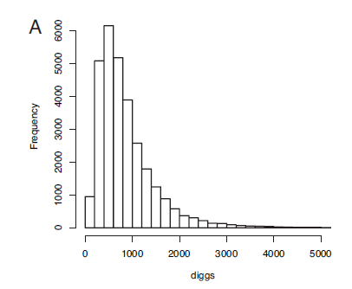
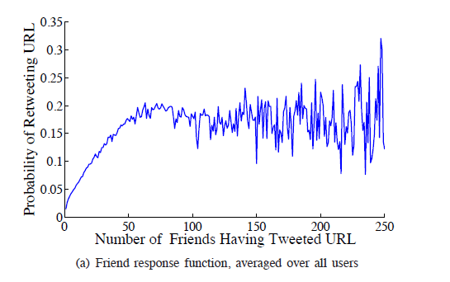
Motivations
CNetS | Center for Complex Networks and Systems Research
Nathan Oken Hodas and Kristina Lerman, How visibility and divided attention constrain social contagion, In ASE/IEEE International Conference on Social Computing (SocialCom-2012)
Fang Wu and Bernardo A. Huberman, Novelty and Collective attention. PNAS, 104 (45),2007
Notes:
The empirical data anaylise from Yahoo, fb, tweeter, shows that, the attenation of each person are limited although people are daily confronted with an increasing amount of information of any kind. And the attention that each news item receives follows log-normal distribution, for the competition of those information, the chance plays a big role. So, based on this idea, we proposed the neutral competitive exclusion model, which can exhibit the homonegenous state, the consense state, and Heterogeneous state, in which different memes can coexhiste.

Slide 5
Neutral Competitive Exclusion Model
i
l
k
i
D | J | N | … | F | U | N | I | D
D
J
N
…
K
U
N
I
D
F
E
F
…
H
W
Y
J
W
G
J
W
…
H
D
Y
D
N
1-p
l
F | E | F | … | H | W | Y | J | W
k
G | J | W | … | F | D | Y | D | N
p
i
D | J | N | … | R | U | N | I | D
l
F | E | R | … | H | W | Y | J | W
k
G | J | W | … | R | D | Y | D | N
Notes:
For easy to be generalied and get anaylictcal solution, we build our neutral competitive exclusion model on the random network. each node represents one individual, and all of the node has the same capaicty, which represent the limited attenation for each individual. And initially, all of the individuals have different memes. At each time step, we randomly chose one node, with probability p, we introduce a new meme and this new meme replace the old one, to keep the capacity a constant. Then, the new meme will spread to the neigbor of the chosen node, and replace the other memes in the neigbos nodes. With probability 1-p, randomly chose one meme in the chose node, and spread it to the neighors. Since in this model, all of node are bening shosen equally, and the same for the memes inside each node. For the evolution result of this model, we fist can consider two extrem situions, when p=0, and p=1.

Slide 6
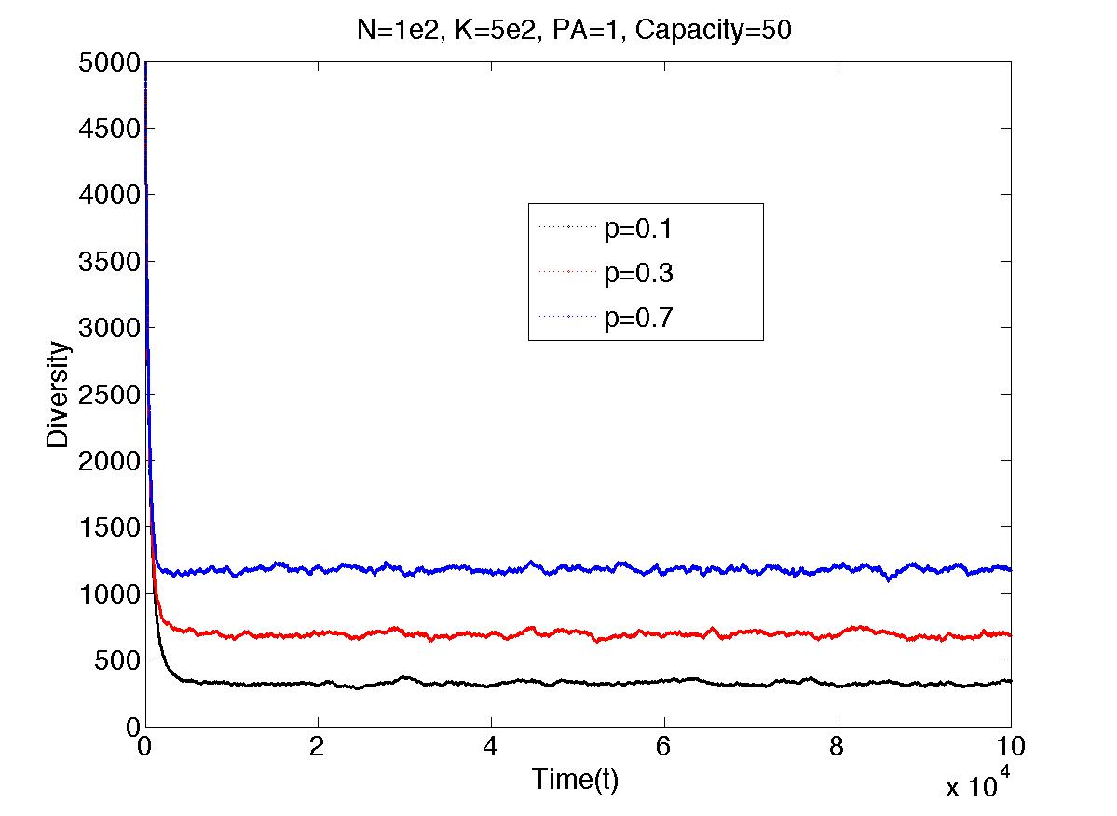
Neutral Competitive Exclusion Model on the Random Network

Slide 7
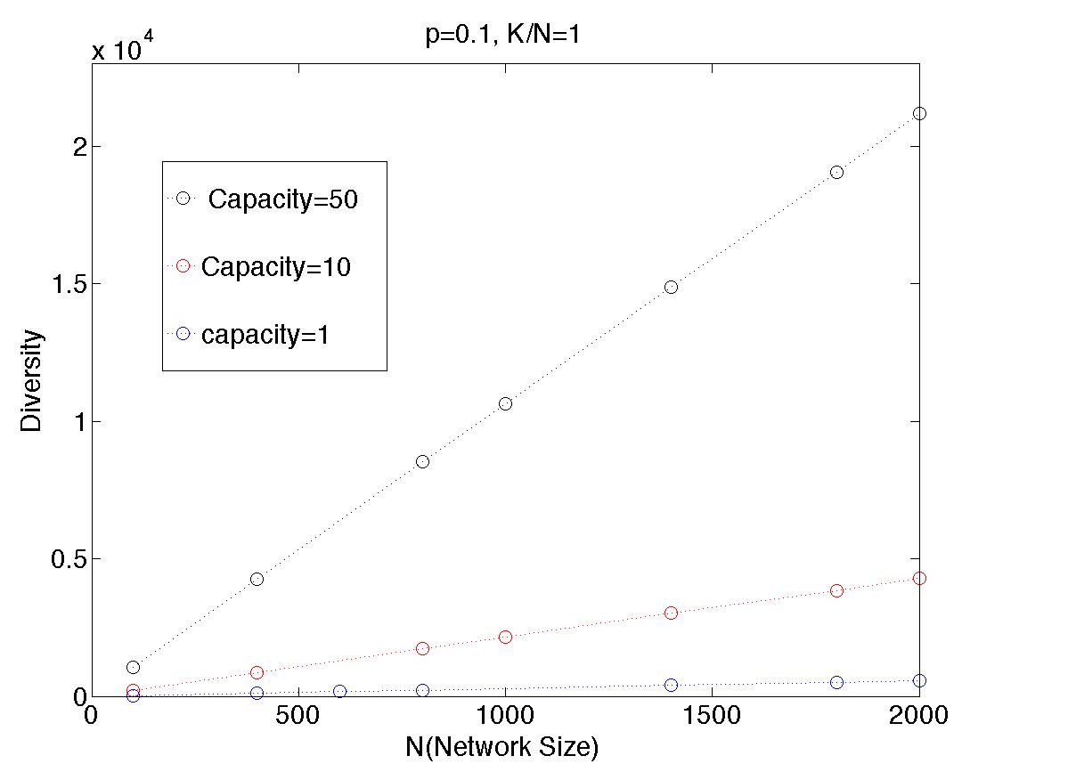
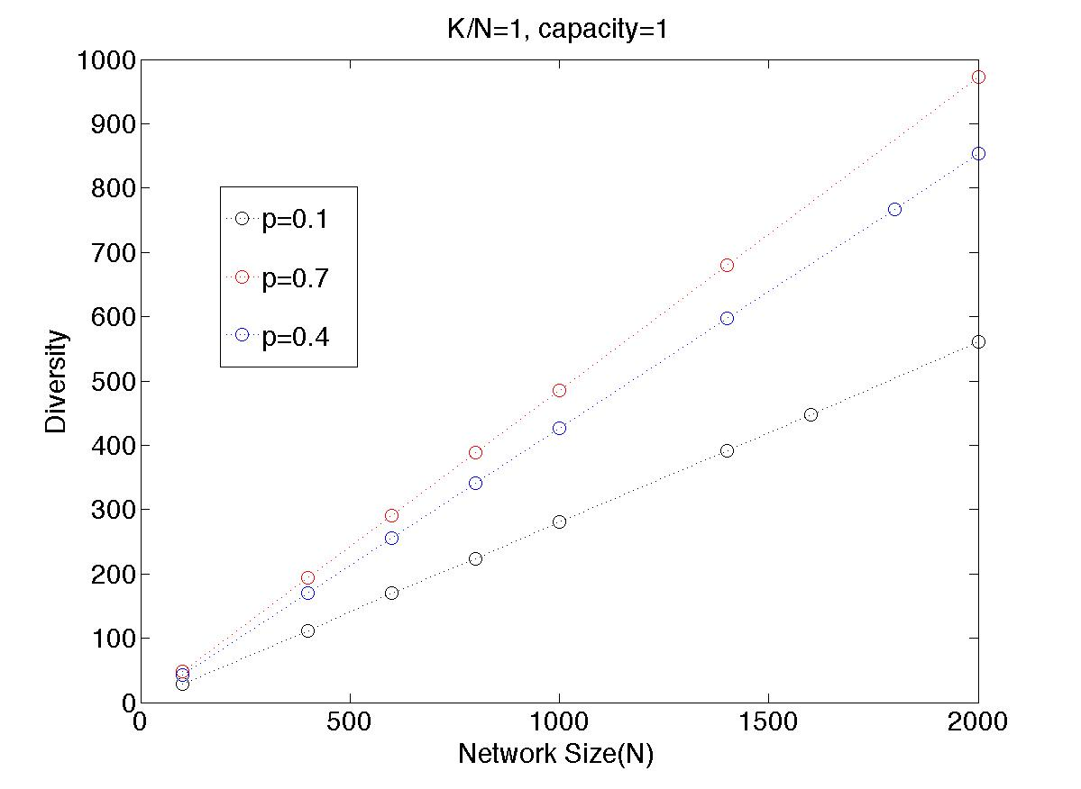
Diversity

Slide 8
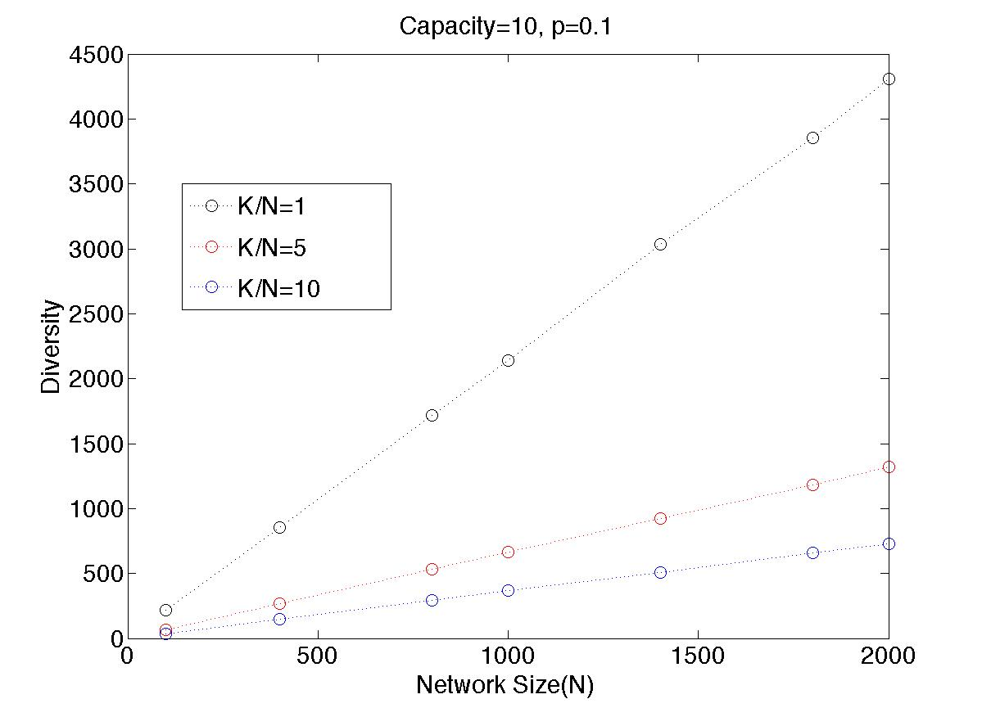

Slide 9
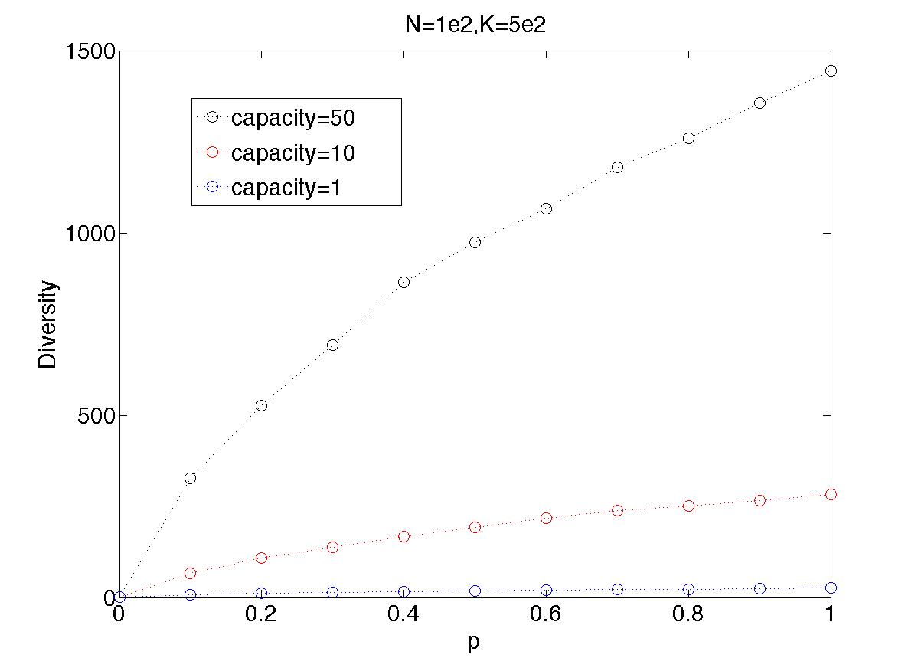
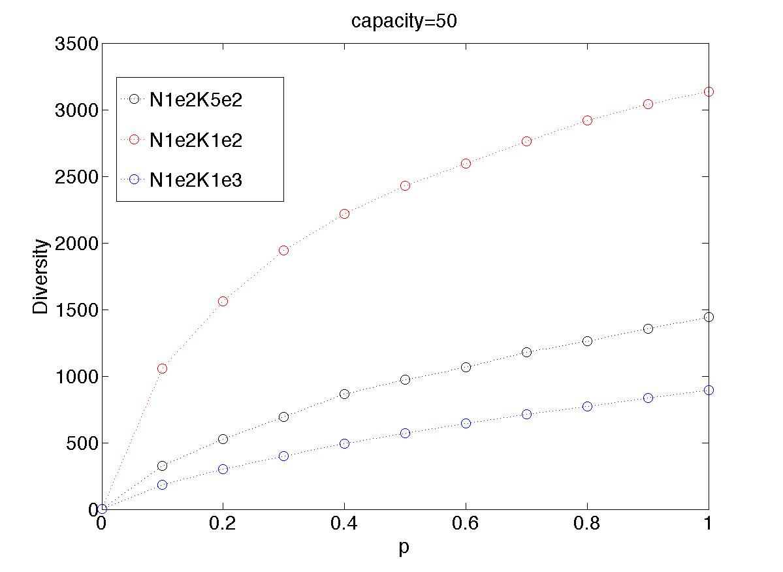

Slide 10
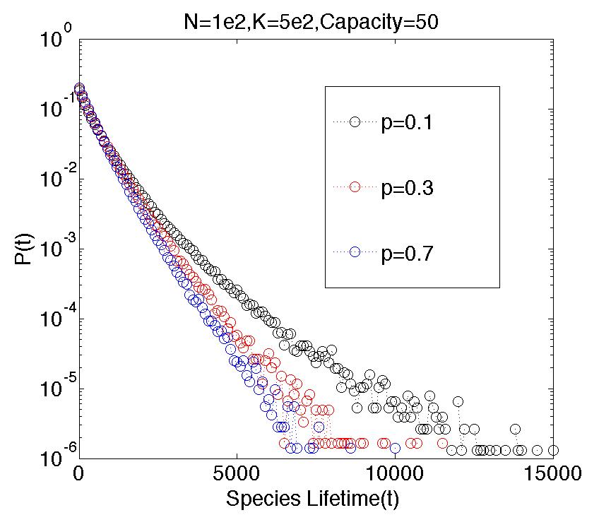
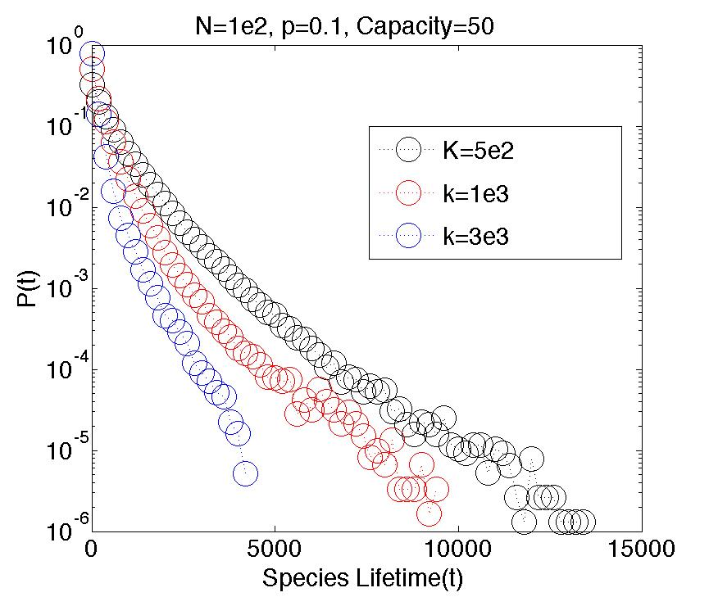
Lifetime

Slide 11
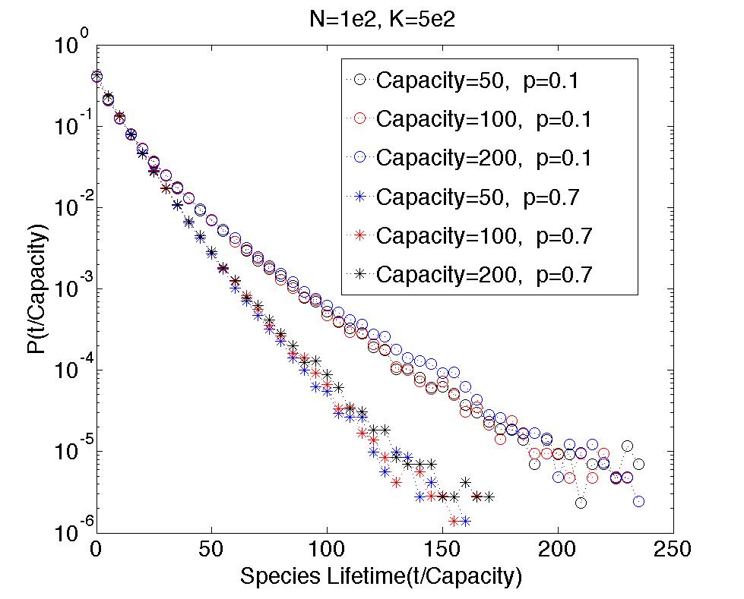
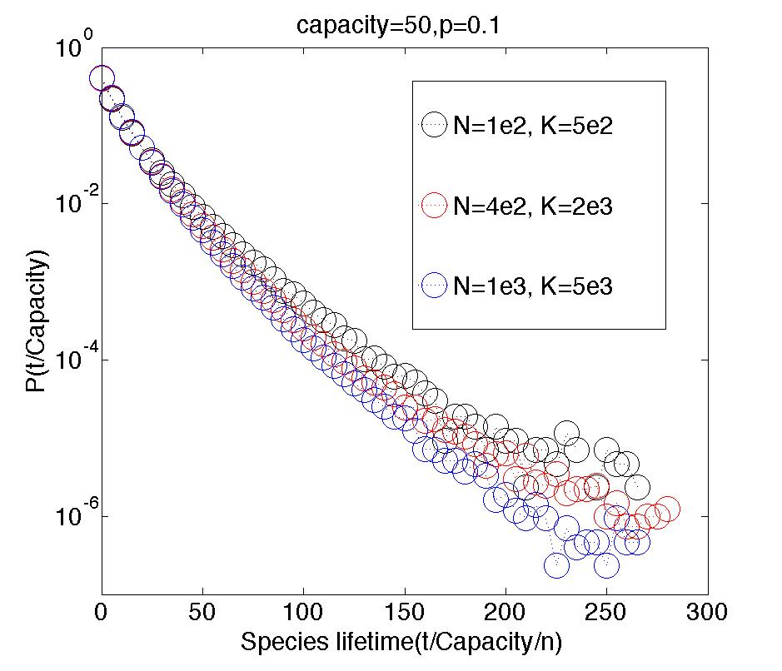

Slide 12
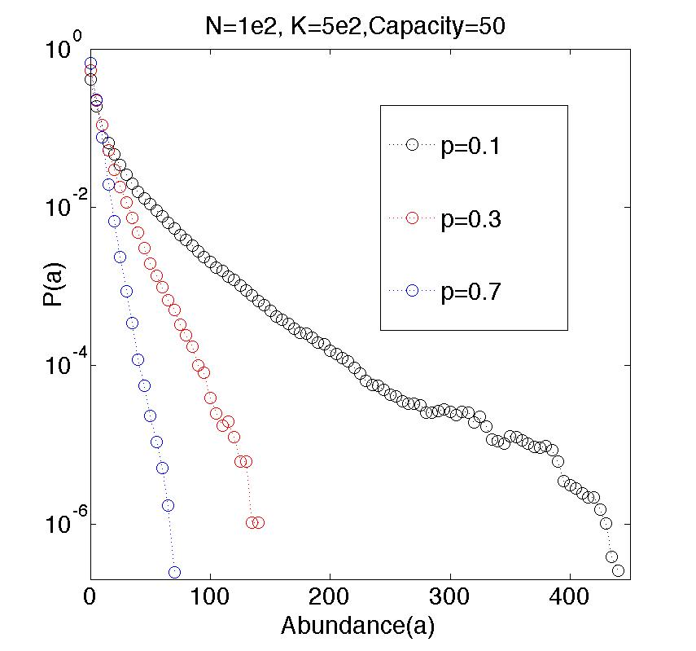
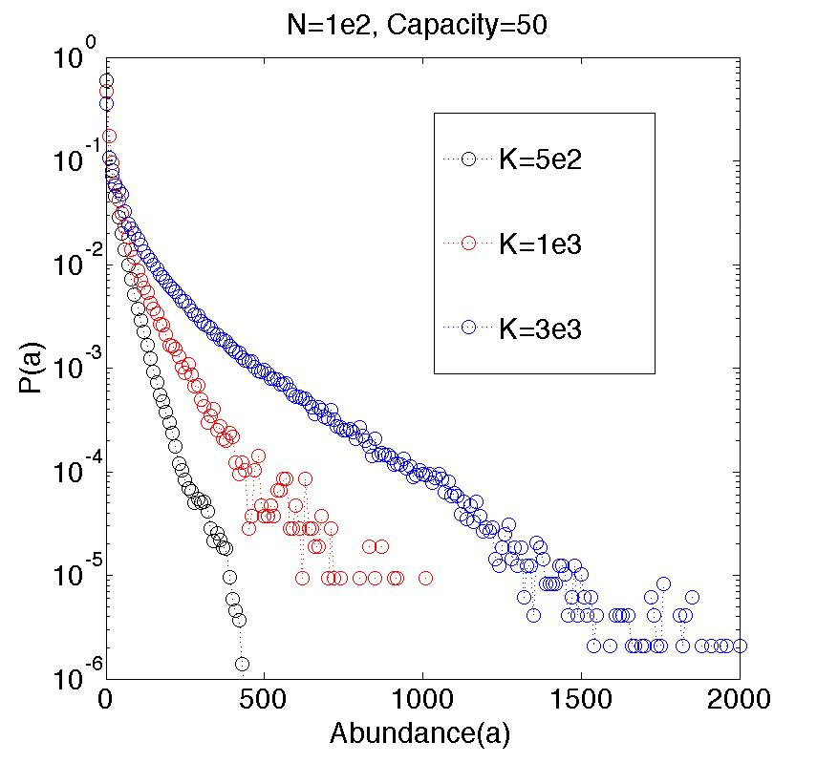
Abundance

Slide 13
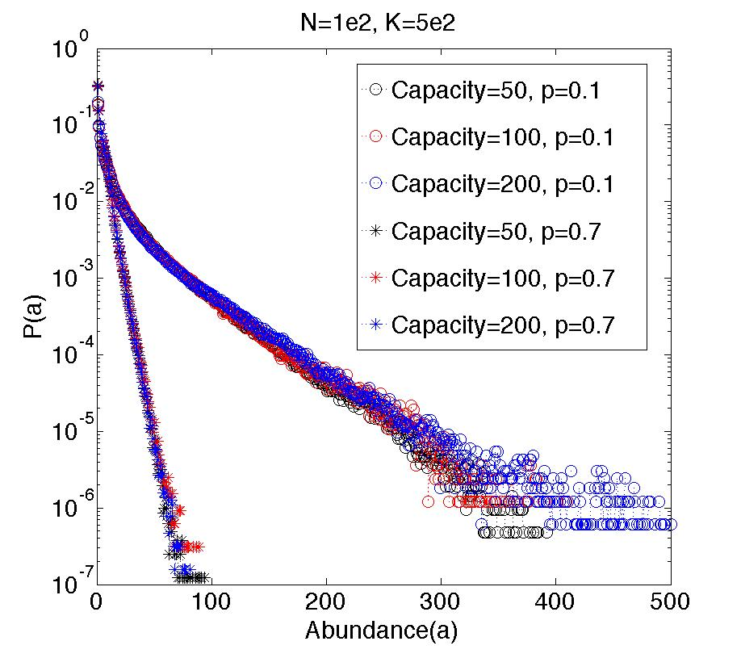
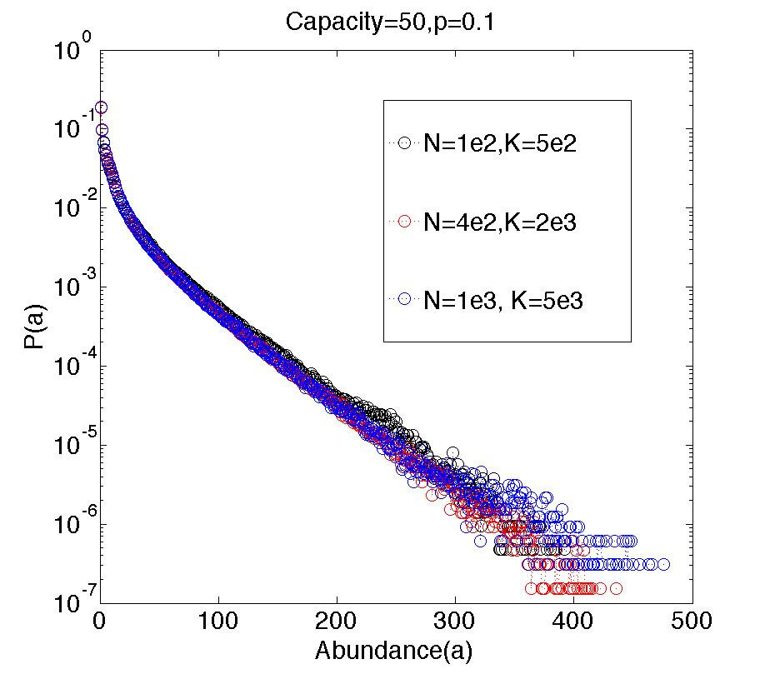

Slide 14
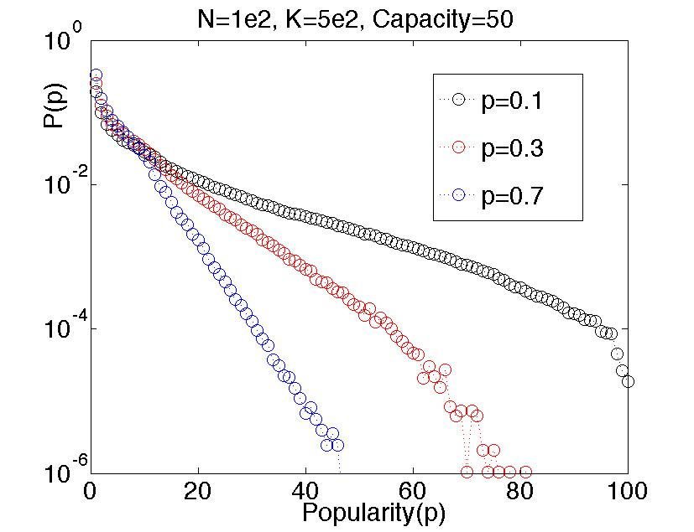
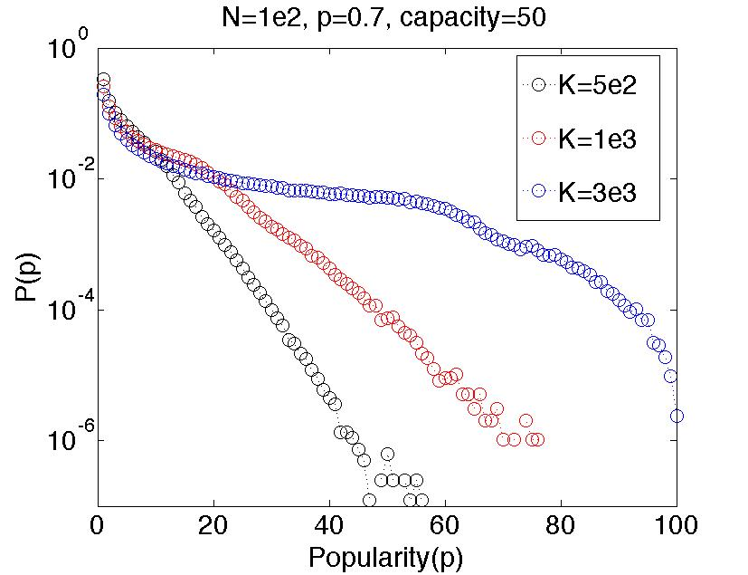
Populartiy

Slide 15
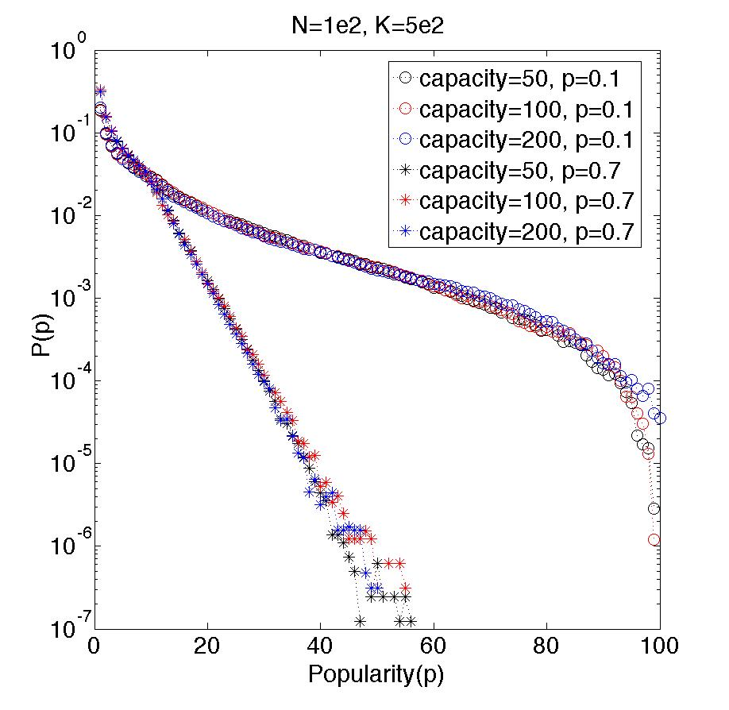
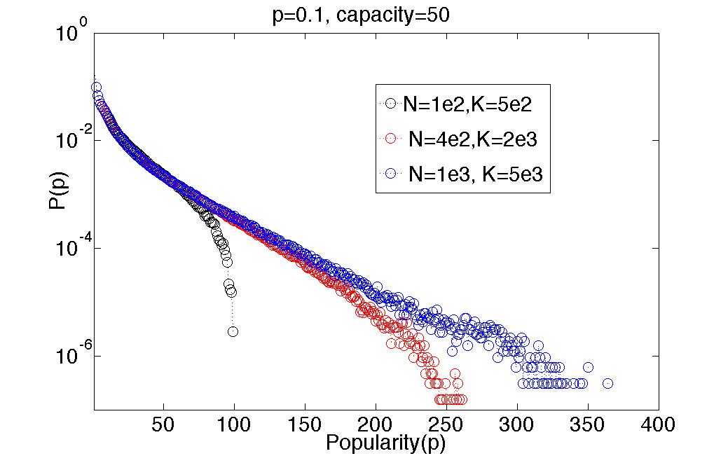

Slide 16
Short Summary
Diversity in the system first decreases and then reaches to 1(when p=0) or a quasistable state with fluctuation(when p ≠ 0) when the system reaches to steady state, and is linear growth with system size, and nonlinear growth with p.
The lifetime is exponential distribution, can be rescaled by capacity and system size. It decreases with increasing p and average degree.
The abundance is exponential distribution, and independent of capacity and system size. It decreases with increasing p, and increases with increasing average degree
The popularity is exponential distribution, and independent of capacity and system size. It is decrease with increasing p, increase with increasing average degree.
Neutral competitive exclusion model generates robust diversity, exponential distribution of lifetime, abundance and popularity. The result are main influenced by p and average degree.

Slide 17
Simplified Toy Neutral Competitive exclusion Model
Neutral Competitive Exclusion Model
i
j
k
D
J
N
…
K
U
N
I
D
F
E
F
…
H
W
Y
J
W
G
J
W
…
H
D
Y
D
N
D
G
N
…
K
U
N
I
D
F
J
F
…
H
W
Y
J
W
G
J
W
…
H
D
Y
D
N

Slide 18
Simplified Toy Neutral Competitive exclusion Model
D
J
N
…
K
J
N
I
D
D
J
N
…
K
U
N
I
D
1-p
D
F
N
…
K
U
N
I
D
p

Slide 19
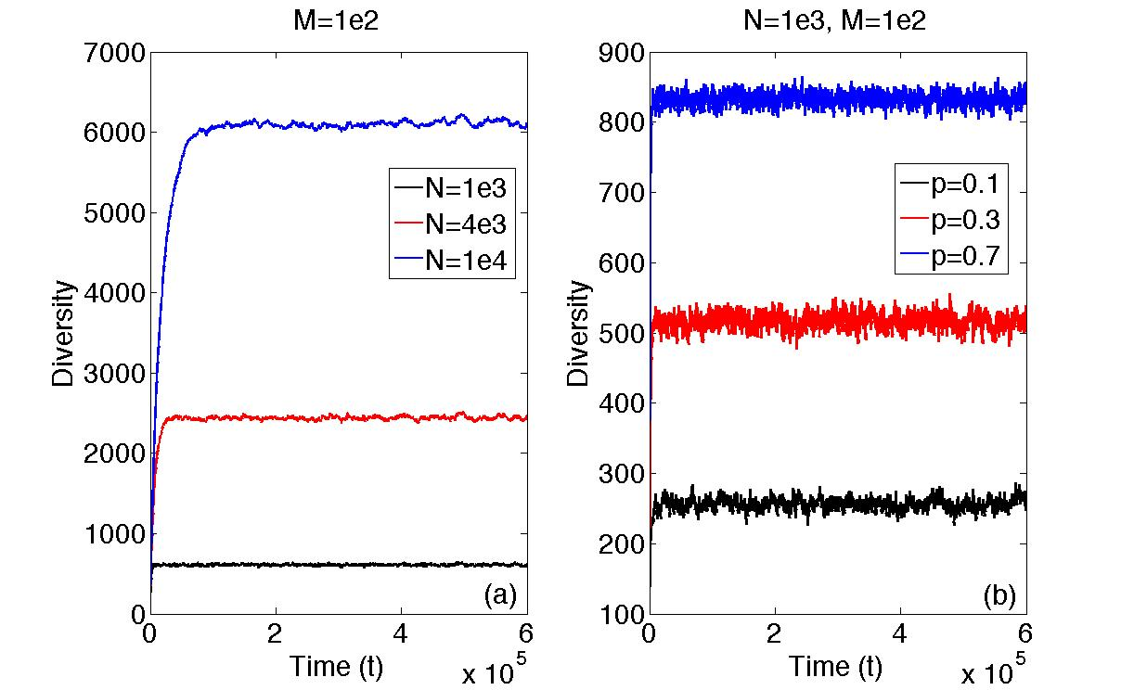

Slide 20
Abundance: Simultaneous equations
f₁ | f₂ | f₃ | f₄ | f₅ | … | f_{k} | … | f_{N-1} | f_{N}

Slide 21
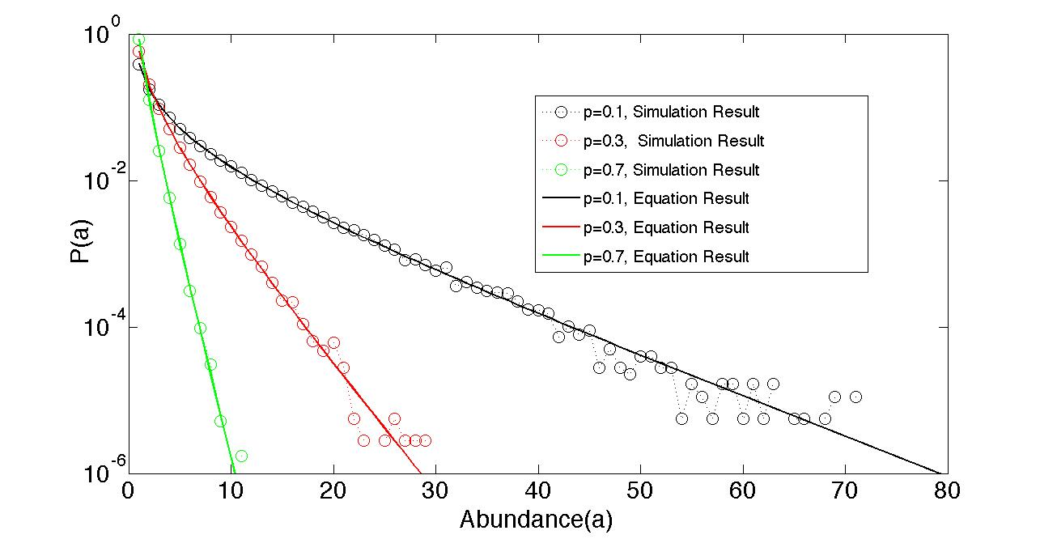

Slide 22
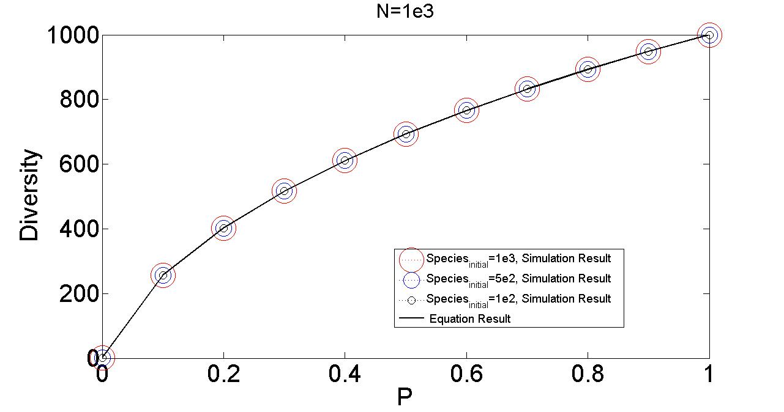

Slide 23
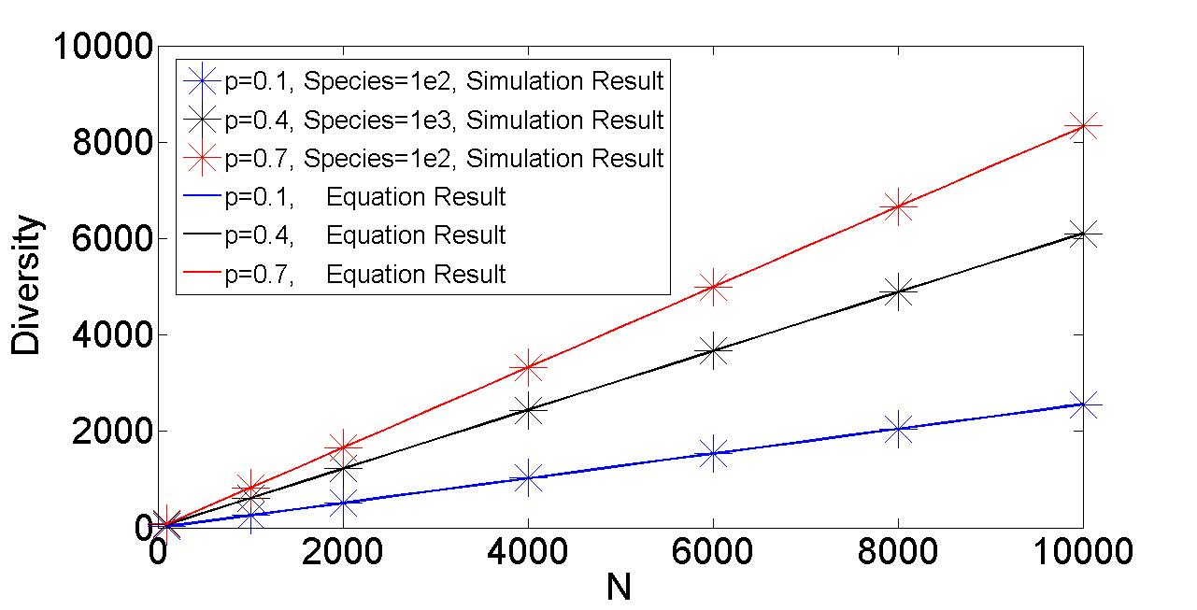

Slide 24
Lifetime : evolution Equation

Slide 25
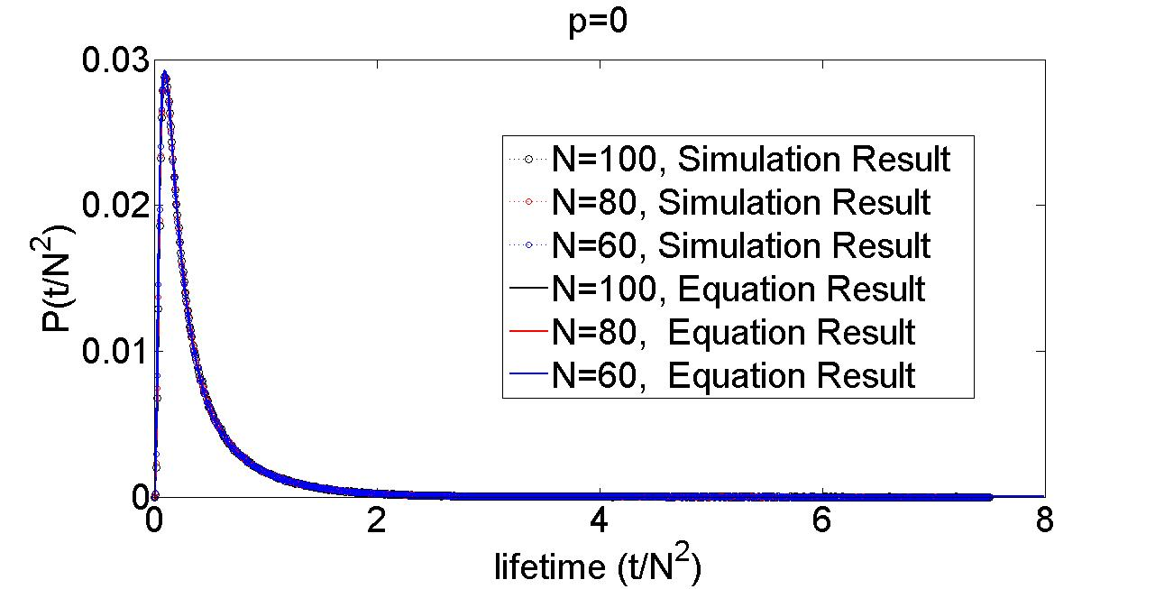

Slide 26
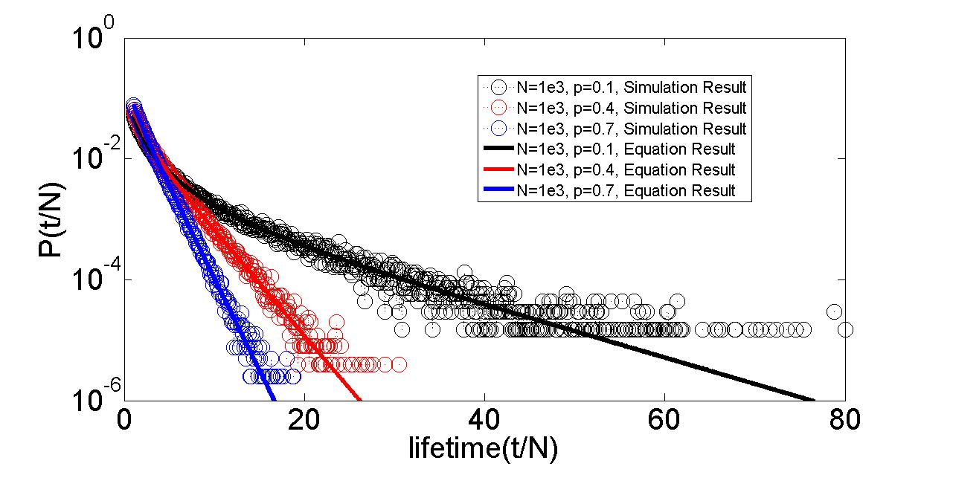

Slide 27
Short Summary
Diversity decreases to 1( when p=0) or increase to N(p=1), or a quasistable state with fluctuation(when 0<p<1) when system reaches to steady state.
Diversity linear growth with system size, and nonlinear growth with p
The lifetime is log-normal distribution (when p=0) or exponential distribution(when p ≠ 0), and decrease with increasing p.
The abundance is exponential distribution and decrease with increasing p

Slide 28

Simplified Toy Neutral Competitive exclusion Model
Neutral Competitive Exclusion Model
i
j
k
D
J
N
…
K
U
N
I
D
F
E
F
…
H
W
Y
J
W
G
J
W
…
H
D
Y
D
N
D
G
N
…
K
U
N
I
D
F
J
F
…
H
W
Y
J
W
G
J
W
…
H
D
Y
D
N
theoretical framework

Slide 29
Evolution Equation for lifetime:
Simultaneous Equations for abundance

Slide 30
Thank you !

